Slide 1


Annual Meeting
October 5, 2013
Rho of Delta Kappa Epsilon International
Rho House Association

Slide 2
Annual Meeting Agenda
Rho House Association
Report on Greek Life (Michael De Lisi ‘03)
Governance Report (Michael De Lisi ‘03)
Treasurer’s Report (Peter Carlson ‘02)
Academic Report (Scott Harris ‘95)
Undergraduate Report (Michael Kelley ‘14)
DKE 160th Anniversary Campaign (Michael De Lisi ‘03)
Introduction to NIBs (Steve Vorvolakos ‘14)

Slide 3




Report on Greek Life
Rho House Association
KDR and Chi Phi still own their houses; Chi Phi dispute with Lafayette College still not resolved
21 fraternities and sororities express interest in Lafayette College since 2008
Notes:
Number of Chapters
New Associate Director Dan Ayala
AISB Update & President Byerly
DKE Strategic Relationships and Standing on Campus

Slide 4


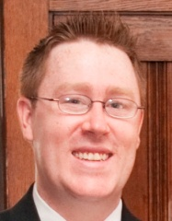


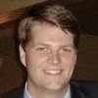

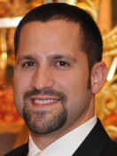



Rho House Association Leadership Team
Rho House Association
Rho News Editor
Jared Piette ‘12
Young Alumni Giving (0-5)
Assistant Director
Michael Rupolo ‘12
Electronic Communications
Manager
John Crerand ‘09
Young Alumni Giving (5-10)
Assistant Director
Rob Hummel ’06 (Pending)
President
Michael De Lisi ‘03
Business
Management
Rob Schiller ‘06
Recruitment
Advisor
John Sheehy ‘05
Treasurer
Investment & Financial Policy Committee
Peter Carlson ‘02
Vice President
House Management
Critical Need
Communications
Public Relations Committee
Critical Need
Art Design
Gabriel Fernandez-Obregon ‘03
Programs
Coordinator
TBD
Chapter Advisor
Risk Management
Brent Souders ‘11
Scholarship
Director
Dr. Asela Gunawardana ‘95
Information Technology
Will Forbes ‘96
Legal
TBD
Chapter Advisor
Member Development
TBD
Historian
Fletcher Thomson ‘98
2013 Critical Needs: VP, Communications, and Board of Directors
4
Revised 10/5/13
Notes:
Number of Chapters
New Associate Director Dan Ayala
AISB Update & President Byerly
DKE Strategic Relationships and Standing on Campus

Slide 5
FY13 Summary of Giving
Rho House Association
Giving to Operations (Rho House Association)
John Wynn '50 | Stuart Daughtridge '86 | Stephen Scioscia '98 | Christian Garelli '09
William Harvey '53 | Victor Diaz-Gonzalez '86 | Timothy Reinking '99 | Joseph Nam '09
Robert Lundquist '55 | Gregory Bahtiarian '87 | Peter Carlson '02 | Peter Crouse '10
Martin Freifeld '69 | Robert Matje '89 | Michael De Lisi '03 | Ryan Simmons '10
Alan McFarland '72 | Kristian Bornemann '91 | Michael Gentile '03 | William engel '10
Richard Moller '83 | Mark Fedorov '91 | John Sheehy '05 | Andrew Casey '11
Christopher Nolan '86 | Asela Gunawardana '95 | Kevin Fitzpatrick '05 | Jared Piette '12
Peter Glock '86 | Scott Harris '95 | Robert Schiller '06 | Michael Rupolo '12
Richard Ryan '86 | Fletcher Thomson '98 | Andrew Kling '08 | Thomas Miglietta '12
Total Raised: $2,090
Expenditures:
Rho News
Homecoming
Faculty Dinner
Insurance
Programming & Capital Giving (Lafayette College for DKE)
William Magee '47 | Neil Avison '76 | Mark Fedorov '91 * | Scott Yunes '03
Dana Hughes '49 | Douglas McCorkle '78 | Mark Suffredini '93 * | Joseph Galyean '04
Richard Heller '49 | Michael Browne '83 * | Brian Waerig '94 | Michael Troxell '05
Edmund Whitby '51 | Richard Moller '83 | Matthew Perez '94 | Jonathan Jaye '10 *
Allan Kirby '53 * | Daniel Huffenus '86 * | Asela Gunawardana '95 * | Conrad Shrager '11
Robert Lundquist '55 | John Sigda '86 | J Bayard Smith '95 | Scott Gordon '12
David White '67 | Richard Ryan '86 | Scott Harris '95 * | William Stern '12
Richard Shupp '67 ** | Todd Wiltshire '86 * | William Forbes '96 | Andrew O'Brien '13 *
Tim Whiting '69 | David Wolff '87 | Lance Lacoff '02 | Charles Laird '13 *
Mark Damiano '74 | Gregory Bahtiarian '87 | Peter Carlson '02 * | Daniel Ladd '13 *
Daniel Moore '75 | Mark Gupta '87 * | Gabriel Fernandez-Obregon '03 | Daniel Toutoungi '13 *
John Krah '75 | Michael McCormack '87 | Michael De Lisi '03 * | David Eckelmann '13 *
Total Raised: $18,976
Expenditures:
DKE x10 Challenge
Undergrad Conf’s
*Marquis Society level gift
**Faculty advisor
FY13 participation rate of 7.9%, prior 6 years averaged 4.0%
FY14 off to a great start, already at 3.3%
Notes:
Review summary of giving
Highlight improving participation
Rho News Cost: $936.76
Dues received through 9/25: $1,635
Past 2 years both came in around $2,000
Subscriptions now make up 41% of dues received
Goals for upcoming year
Get DKE onto QuickBooks
Soliciting volunteers to help
Automate dues recognition on website so you can always see if you’re current
Execute investment policy committee asset allocation
Investigate possibility of creating undergraduate investment club

Slide 6
Academics Report
Rho House Association
What we've done in 2013
  Solidified a culture of academic importance – separately targeting individuals, classes, pledges, and recruits- but most importantly throughout the house.
  Put in processes to focus on grades; keep our academic profile off of the college's radar; and strive to make our academics part of DKE's selling point.
Who we're working with (relationship building)
  Annette Diorio, VP for Campus Life regarding our academic strategy
  Dan Alaya, Ass. Director for Residence Life, for tactical interactions with the school
  The registrar, to drive an understand that our members’ grades allows us to understand performance and act in alignment with Lafayette's Greek academic goals.
Significant accomplishments
  Established a vision for our academics
    All members graduate on time
    Win the academics competition of the lion trophy
    Continue the progress that we’ve made over the past two years
  Oversaw an increase in GPA by 0.2 between fall 2012 and spring 2013
  Understood and communicated the root cause between recruiting and grades
Future challenges
  Keep the level of requests of the alumni association to the undergrads to a balanced level
  Continue to have high expectations for undergraduate leadership and body
  Continue connecting rush processes to academic performance
  Maintain administration relationships to support our academic and larger reputation

Slide 7
Chapter
Strategic Planning
Delta Kappa Epsilon International
Rho Chapter of Delta Kappa Epsilon Fraternity
Notes:
Hesitation behaviors/reactions:
i. Strategic planning? What is that?;
ii. Strategic planning sounds pretty heavy for a bunch of undergraduates;
iii. I don’t have enough time for this;
iv. My chapter doesn’t need this—we’re fine already.
v. Why go to all this trouble when we’re already one of DKE’s best chapters?
Strategic planning is the process by which you define a vision for your organization and drive to achieve said vision with a structure of smart action-items, goals, initiatives, and yearly missions. Clarity and accountability are enhanced, aiding achievement.
Strategic planning does sound pretty heavy, but it is actually quite simple—perhaps one of the easiest exercises you’ll perform while in school.
Strategic planning should actually SAVE you a lot of time. Invest planning time now to save time later.
Have you had any ups and downs? Ever want to maximize the up moments and minimize the down moments? This will help you get better.
Why stop there? Use strategic planning to be one o the best in the continent.

Slide 8
Strategic Planning
Core Values
Vision Statement
Mission
Strategic Initiatives
Goals
  “Rho of Delta Kappa Epsilon is a values based brotherhood that inspires leadership, intellectual curiosity, respect, and honor in our brothers with commitment to our fraternity and traditions as part of a vibrant Greek community actively engaged with Lafayette College.”
Core Values
Core Values
Notes:
Written by the students in the Rho Chapter of DKE on Saturday, August 25, 2012 to guide them for the next 3 years.

Slide 9
Strategic Planning
Core Values
Mission Statement
-
-
-
  “Continue to strengthen our fraternity through the recruitment of quality brothers, reinforcement and advancement of academic standards, emphasis of lifelong commitment to brotherhood and to DKE, and more active engagement in our community by collaborating with Lafayette organizations.” – Rho, Lafayette College
Core Values
Core Values
Notes:
Written by the students in the Rho Chapter of DKE on Saturday, August 24, 2013 to guide them for the 2013-2014 academic year.

Slide 10
DKE Strategic Initiatives
Strategic Planning
Scholastic Excellence Initiative
Service Initiative
Expand and enhance philanthropy and community service outreach through increased events and cooperation with other organizations on the campus community
Community Engagement Initiative
Stronger outreach to alumni base through various methods while reinforcing lifelong commitment and bonds to all undergraduate members
Continue to implement and achieve a house wide academic culture in which each brother graduates on time in good academic standing
Notes:
Written by the students in the Rho Chapter of DKE on Saturday, August 24, 2013 to guide them for the 2013-2014 academic year.

Slide 11
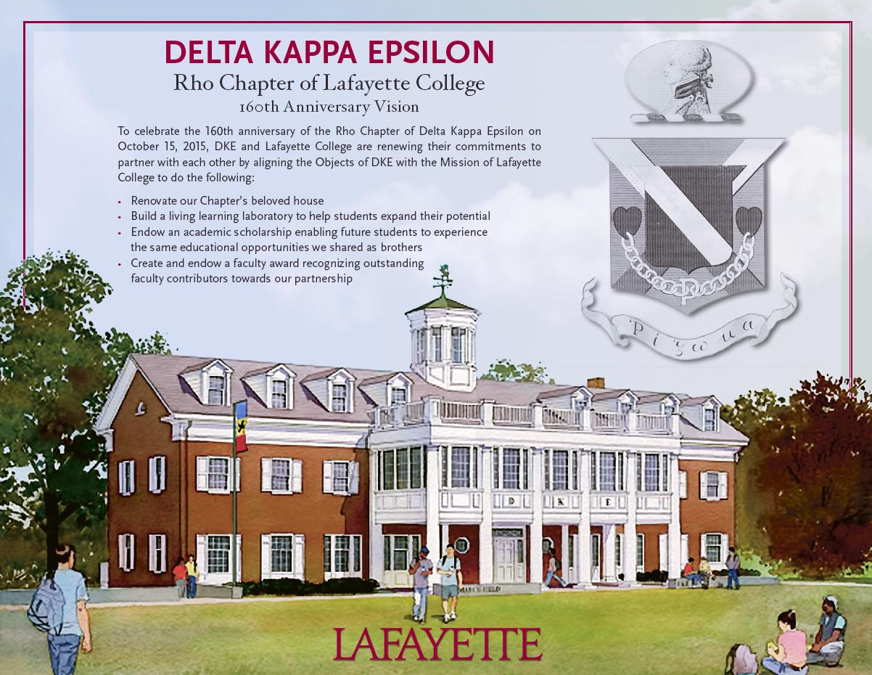
DKE 160th Anniversary Campaign
Rho House Association
Notes:
Number of Chapters
New Associate Director Dan Ayala
AISB Update & President Byerly
DKE Strategic Relationships and Standing on Campus

Slide 12
Fundraising Progress
Rho House Association

Slide 13
Annual Meeting
Adjournment
Rho of Delta Kappa Epsilon International
NIBs, Lion March, Chapter Photo, Tailgate, Oktoberfest
Notes:
Hesitation behaviors/reactions:
i. Strategic planning? What is that?;
ii. Strategic planning sounds pretty heavy for a bunch of undergraduates;
iii. I don’t have enough time for this;
iv. My chapter doesn’t need this—we’re fine already.
v. Why go to all this trouble when we’re already one of DKE’s best chapters?
Strategic planning is the process by which you define a vision for your organization and drive to achieve said vision with a structure of smart action-items, goals, initiatives, and yearly missions. Clarity and accountability are enhanced, aiding achievement.
Strategic planning does sound pretty heavy, but it is actually quite simple—perhaps one of the easiest exercises you’ll perform while in school.
Strategic planning should actually SAVE you a lot of time. Invest planning time now to save time later.
Have you had any ups and downs? Ever want to maximize the up moments and minimize the down moments? This will help you get better.
Why stop there? Use strategic planning to be one o the best in the continent.

Slide 14
Annual Meeting
October 5, 2013
Rho of Delta Kappa Epsilon International
Rho House Association
Backup Slides
Notes:
Hesitation behaviors/reactions:
i. Strategic planning? What is that?;
ii. Strategic planning sounds pretty heavy for a bunch of undergraduates;
iii. I don’t have enough time for this;
iv. My chapter doesn’t need this—we’re fine already.
v. Why go to all this trouble when we’re already one of DKE’s best chapters?
Strategic planning is the process by which you define a vision for your organization and drive to achieve said vision with a structure of smart action-items, goals, initiatives, and yearly missions. Clarity and accountability are enhanced, aiding achievement.
Strategic planning does sound pretty heavy, but it is actually quite simple—perhaps one of the easiest exercises you’ll perform while in school.
Strategic planning should actually SAVE you a lot of time. Invest planning time now to save time later.
Have you had any ups and downs? Ever want to maximize the up moments and minimize the down moments? This will help you get better.
Why stop there? Use strategic planning to be one o the best in the continent.

Slide 15
FY13 Dues Paying Members
Rho House Association
John Wynn '50
William Harvey '53
Robert Lundquist '55
Martin Freifeld '69
Alan McFarland '72
Richard Moller '83
Christopher Nolan '86
Peter Glock '86
Richard Ryan '86
Stuart Daughtridge '86
Victor Diaz-Gonzalez '86
Gregory Bahtiarian '87
Robert Matje '89
Kristian Bornemann '91
Mark Fedorov '91
Asela Gunawardana '95
Scott Harris '95
Fletcher Thomson '98
Stephen Scioscia '98
Timothy Reinking '99
Peter Carlson '02
Michael De Lisi '03
Michael Gentile '03
John Sheehy '05
Kevin Fitzpatrick '05
Robert Schiller '06
Andrew Kling '08
Christian Garelli '09
Joseph Nam '09
Peter Crouse '10
Ryan Simmons '10
William engel '10
Andrew Casey '11
Jared Piette '12
Michael Rupolo '12
Thomas Miglietta '12

Slide 16
FY14 Summary of Giving
Rho House Association
Giving to Operations
Programming and Capital Giving
William Magee '47
Richard Heller '49
John Wynn '50
Matthias Sheeleigh '50
Joseph Pew '55
Edwin Case '59
Thomas Neff '59
John Hossenlopp '61
Robert Rothman '66
Alan McFarland '72
Richard Moller '83
Victor Diaz-Gonzalez '86
Gregory Bahtiarian '87
Mark Fedorov '91
Eric Abbott '92
Mark Suffredini '93
Asela Gunawardana '95
J Smith '95
Scott Harris '95
Fletcher Thomson '98
Timothy Reinking '99
Peter Carlson '02
Jonathan Winn '07
Christian Garelli '09
William engel '10
Bradley Helland '10
Jared Piette '12
David White '67
Douglas McCorkle '78
Eli Lambert '83
Asela Gunawardana '95
J Smith '95

Slide 17
Interest in Lafayette College 6/1/2013
Rho House Association
Date of expressed Interest | HQ | Alum | Students | Group Name | Umbrella | New to LC? | Closure/Dormat | Other times contacted | Other times contacted | Other times contacted
3/28/2013 |  |  | x | Zeta Beta Delta | Local Sorority | Yes | n/a
2/7/2013 | x | x |  | Pi Lambda Phi | NIC | No | 1982 | 12/7/2011
1/22/2013 | x |  | x | Kappa Alpha Psi | NPHC | Yes | n/a | 12/7/2012 | ########
9/18/2012 | x |  | x | Theta Delta Chi | NIC | No | 2001 | 1/9/2007
12/8/2012 | x | x |  | Delta Tau Delta | NIC | No | 1988 | 12/9/2011 | ########
12/8/2012 | x |  |  | Sigma Chi | NIC | No | 1997 | 5/25/2010
7/27/2012 | x |  |  | Alpha Chi Omega | NPC | Yes | n/a
3/12/2012 | x | x | x | Omega Psi Phi | NPHC | Yes | n/a | 4/13/2012 | 9/11/2012 | #######
1/3/2012 | x |  | x | Delta Sigma Theta | NPHC | Yes | n/a | 12/6/2011
10/26/2012 | x |  | x | Theta Chi | NIC | No | 2003 | 7/22/2011 | 5/19/2010
7/8/2012 | x |  |  | Alpha Sigma Phi | NIC | Yes | n/a | 7/8/2012 | 5/19/2009
9/7/2011 | x |  | x | Chi Phi | NIC | Yes | 2005 | 8/9/2011
3/24/2009 | x |  |  | Alpha Phi Omega | Service/Prof | No | n/a | 11/8/2005 | 2/28/2011 | #######
5/15/2007 | x |  |  | Phi Delta Theta | NIC | No | 1993
1/26/2007 | x |  |  | Alpha Delta Pi | NIC | Yes | n/a | 1/26/2006
11/20/2006 | x |  |  | Sigma Alpha Epsilon | NIC | No | 1997 | 10/6/2005
1/22/2006 | x |  |  | Alpha Delta Phi | NPC | No | n/a
9/16/2005 | x |  |  | Psi Upsilon | NIC | Yes | n/a
5/25/2005 | x | x |  | Kappa Sigma | NIC | No | 1986 | 4/11/2005
5/20/2005 | x |  |  | Theta Xi | NIC | Yes | 1972
5/13/2005 | x |  |  | Sigma Kappa | NPC | No | 1990

